Slide 1

What’s new in VS 2017?
Alfred Jett Grandeza
Co-founder, Leangineer @ Lean Consulting / Lean Academy
leanconsulting.ph | leanacademy.ph | ajgrandeza.com

Slide 2

HAPPY 20th BIRTHDAY VISUAL STUDIO!

Slide 3
RELEASE DATE:
MAR 7, 2017

Slide 4

Download Visual Studio 2017 by March 14,
get free 60-day access to Xamarin University.

Slide 5
NEW INSTALLATION EXPERIENCE

Slide 6
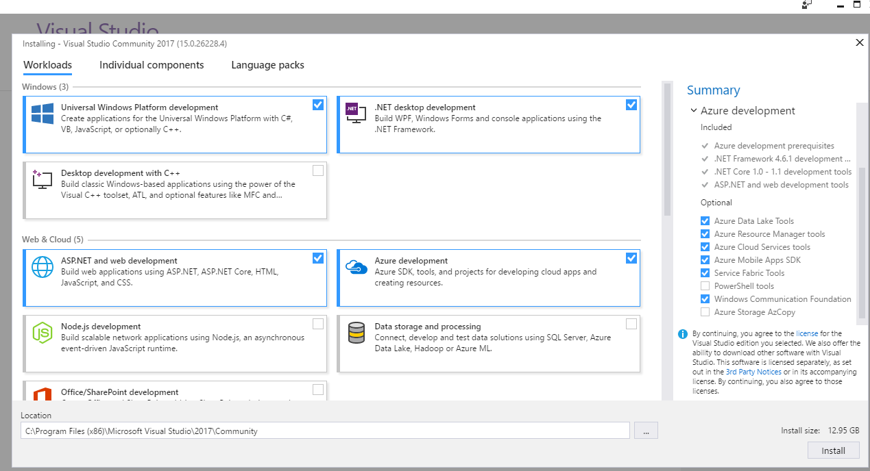

Slide 7
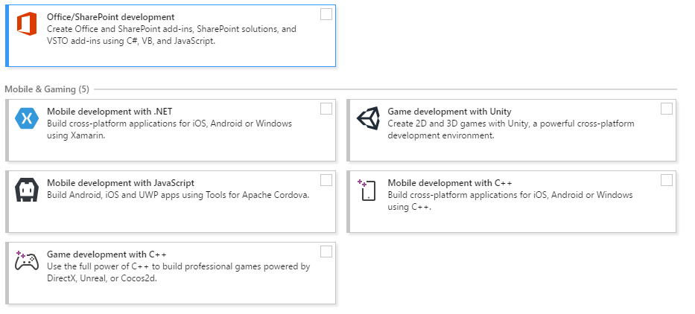

Slide 8
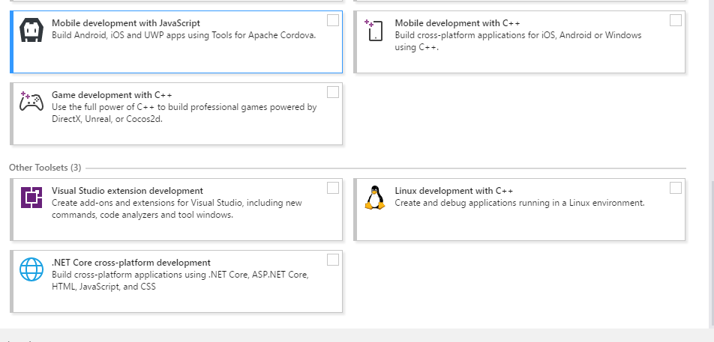

Slide 9
MODIFYING INSTALLATIONS
DEMO

Slide 10
IDE IMPROVEMENTS

Slide 11
Start Page
News section is collapsible
Easier access to Visual Studio Team Services
Create a new project directly from the Start Page with searchable templates and a list of recently used templates.

Slide 12
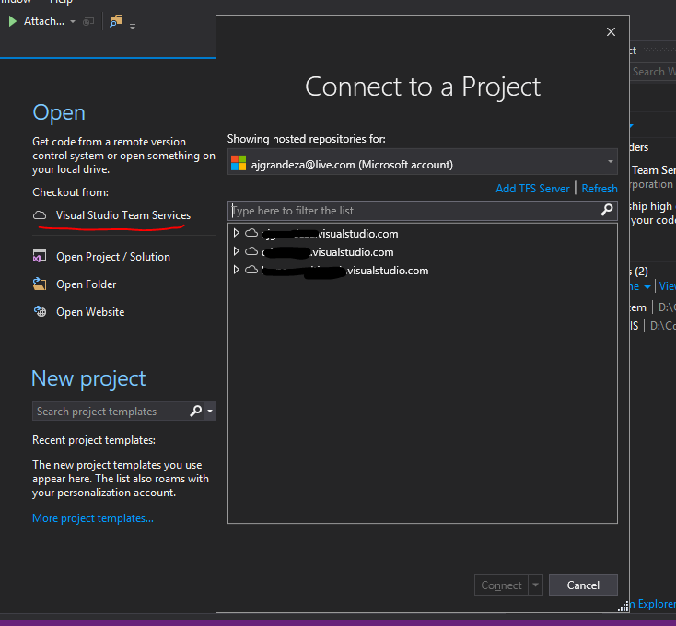

Slide 13
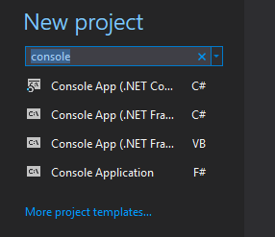
Demo

Slide 14
CODE NAVIGATION
MADE BETTER!

Slide 15
CTRL + , or CTRL + T

Slide 16
SHIFT + F12
FIND ALL REFERENCES

Slide 17
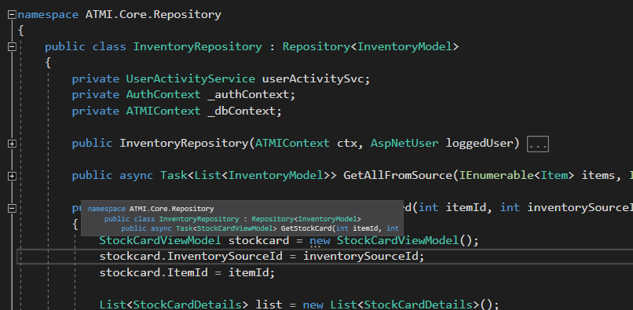
Structure Guide Lines

Slide 18
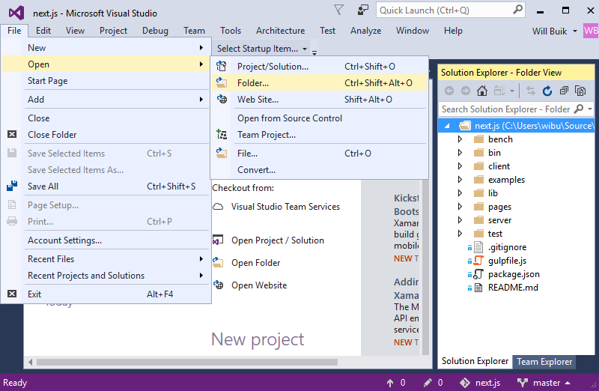
Open Folders
Open folders without
projects and/or solutions

Slide 19
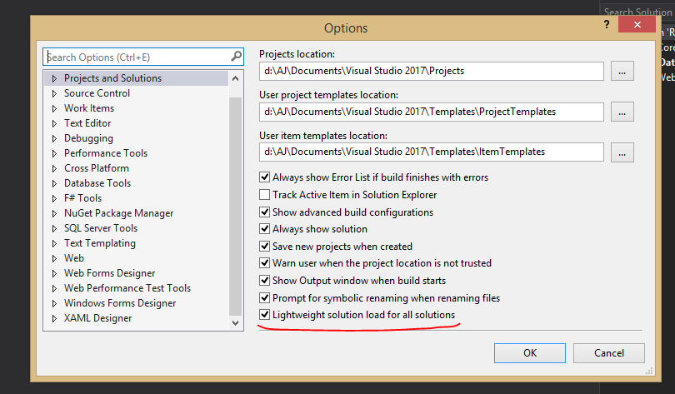
Lightweight Solution Load
Demo

Slide 20
Intellisense Improvements
An icon tray has been added to IntelliSense that enables you to filter the member list by type (e.g., methods, properties, classes, etc.).
To enable this feature, go to Tools > Options > Text Editor > [C# / Basic] > IntelliSense and check the options for filtering and highlighting.
Demo

Slide 21
Debugging

Slide 22
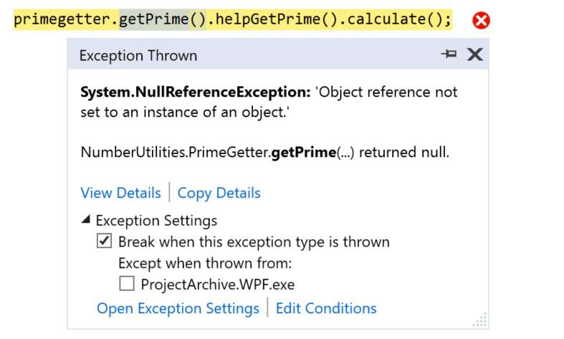
The New Exception Helper

Slide 23
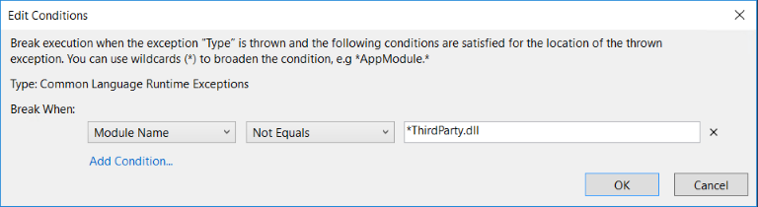
Add Conditions to Exception Settings

Slide 24
OTHER UPDATES

Slide 25
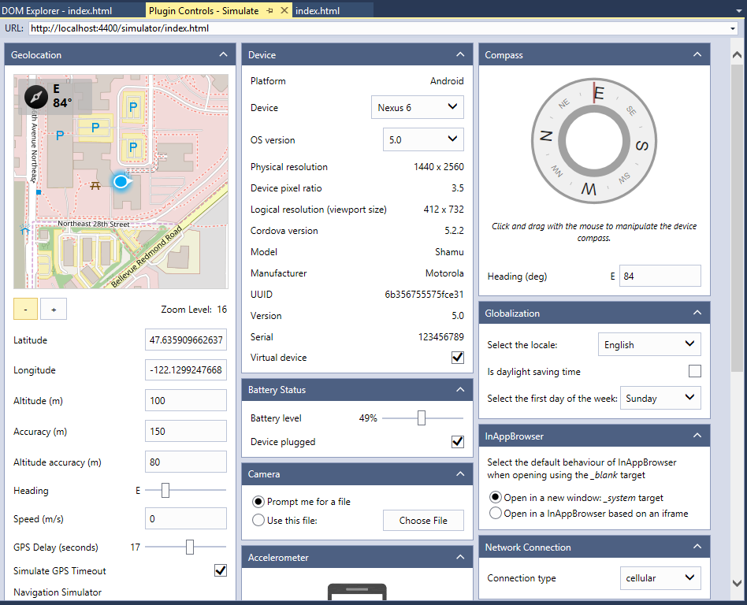
Cordova Simulate
A new browser-based simulator enables you to code fast and see the results immediately in the browser.
Live reload, plugin simulation, and support for Ionic Framework give Visual Studio the fastest developer workflow on the market.

Slide 26

VS 2017 runs lighter than previous versions

Slide 27
ANY QUESTIONS?
VISIT ajgrandeza.com to get this slide

Slide 28
References
https://channel9.msdn.com/Events/Visual-Studio/Visual-Studio-2017-Launch/100
https://www.visualstudio.com/en-us/news/releasenotes/vs2017-relnotes
Download: https://www.visualstudio.com/thank-you-downloading-visual-studio/?sku=Community&rel=15

